Slide 1
UNIT 5
DESIGN AND ANALYSIS OF MACHINE LEARNING EXPERIMENTS

Slide 2
Guidelines for Machine Learning Experiments
Aim of the Study
Selection of the Response Variable
Choice of Factors and Levels
Choice of Experimental Design
Performing the Experiment
Statistical Analysis of the Data
Conclusions and Recommendations

Slide 3
Resampling
Resampling is a technique used in machine learning to evaluate the performance of a model and reduce the risk of overfitting.
It involves creating multiple training and testing sets from the original data set, and training and testing the model on each of these sets.
Two main types:
Cross-validation
Bootstrap

Slide 4
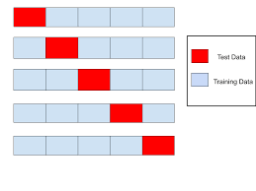
Cross-validation
Validating the model efficiency by training it on the subset of input data and testing on previously unseen subset of the input data.
Used to validate the stability of the model

Slide 5
K-FOLD CROSS-VALIDATION
The steps for k-fold cross-validation are:
Split the input dataset into K groups
For each group:
Take one group as the reserve or test data set.
Use remaining groups as the training dataset
Fit the model on the training set and evaluate the performance of the model using the test set.

Slide 6
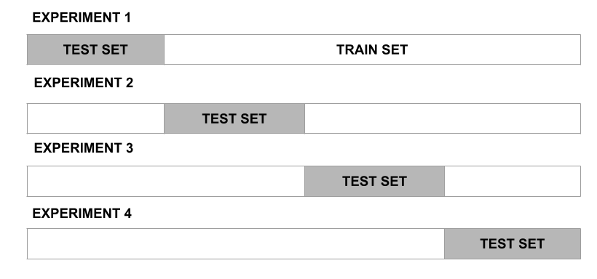

Slide 7
Applications of Cross-Validation
This technique can be used to compare the performance of different predictive modeling methods.
It has great scope in the medical research field.
It can also be used for the meta-analysis

Slide 8
Comparison of Cross-validation to train/test split in Machine Learning

